Slide 1
Introduction to Data Science
Dr. Kristopher Keipert
Material Created by Dr. Jeff Layton
September 16, 2020

Slide 2
Introduction
The goal of data science is to discover knowledge from the data set
Mix of math, statistics, data analysis, machine learning
Includes visualization as much as possible
Jim Gray “imagined data science as the ‘fourth paradigm’ of science”
Different from Machine Learning but you need to keep ML in mind
The first step in Data Science is to explore your data set
Goal is to “understand your data set” (before using ML)
Second goal is to extract information, and hopefully, information from data set
Don’t willy-nilly apply DL/ML concepts to your data set
It will be meaningless (and a waste of time)

Slide 3
Introduction
Goal is Understanding
How many data points in the data set? (rows) How many independent and dependent variables? (cols)
“bounds” of data set (min, max, range)
Basic stats (mean, median, mode, standard deviation) for each variable
What does a scatter plot of the dependent variable(s) look like? (versus two independent variables)
Lots of scatter in the data? Is the data tightly grouped?
Are there any (many) outliers?
How many clusters are there?
What independent variables are important?
How are independent variables related? (correlation)
Clustering Analysis, Model reduction
Notes:
There are lots of “goals” or objectives for understanding your data set.
Some of them are generic and some are specific.
All of them are important (don’t leave a stone unturned)
Don’t just jump into ML/DL models – they will be meaningless

Slide 4
Goals of Workshop
I don’t want to turn you into a data scientist, but I want you to have some idea of how to examine your data from a “data science” perspective
I won’t be going over each cell in the notebook
Review them when you can
Think critically about what the data is “telling” you
I will be asking if you have observations about the data
Going to examine two data sets:
The first one is simple
Second one is more complex

Slide 5
First Data set

Slide 6
Height, Weight, Gender
Kaggle Data Set
Start with simple data set
Learn techniques
Learn how to critical examine results
10,000 data points
Height (inches), Weight (lbs); Male, Female
Data set is in csv (comma separated values)
Common with Excel. Very easy to read.
Using Pandas as our data science tool
Don’t need a GPU for this workshop

Slide 7
Load needed libraries and read data
For now, just use Pandas and NumPy
Data is stored in a subdirectory named “data”
Data is read into a “data frame”
Name “dataset” for this case
(Instantiation of class)
This is not a simple table
There are many, many methods to help us explore and understand our data
Run the notebook cell
import pandas as pd
import numpy as np
dataset = pd.read_csv("data/weight-height.csv")
Notes:
Read the csv data set into a data frame named “dataset”.

Slide 8
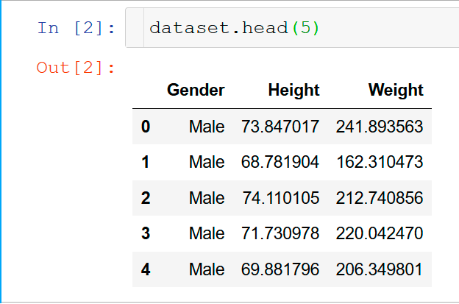
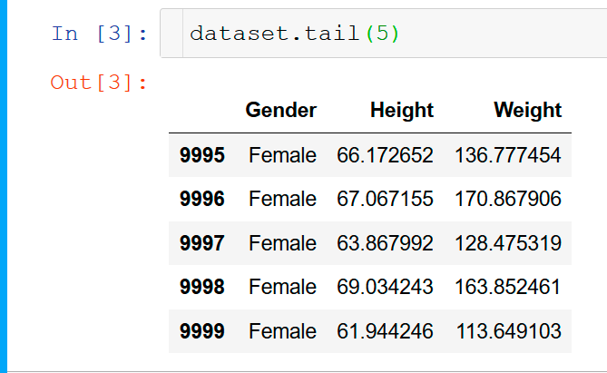
Head and Tail of data frame
Run the cell in the notebook
Notes:
These are methods or “functions” associated with the data frame object.
You can change the number of values by changing the “5” to another number.

Slide 9
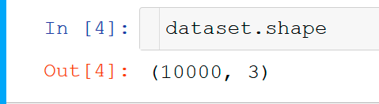
SHAPE of Data
Pandas Objects has a number of attributes
“shape” is one of the them
“size” is another
There are also a number of methods associated with the object (lots of them!)
Some are data manipulation functions
Some do computations
Some do plots
Attributes and Methods are extremely useful!
https://pandas.pydata.org/pandas-docs/stable/reference/api/pandas.DataFrame.html
Notes:
“shape” is an attribute of the object. There are lots of attributes and methods

Slide 10
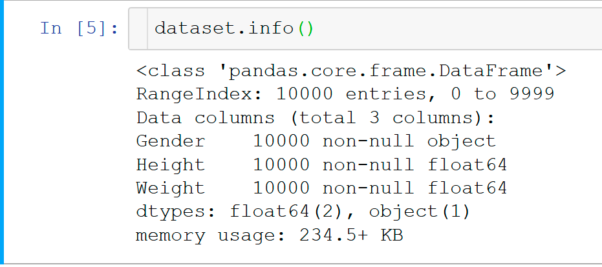
Info() method
Run the cell in the notebook
Notes:
Another method in the data frame object
What do you notice?
Number of "non-null" data points (it should be the same as the output from the "shape" method)
Datatype for each variable.
Amount of memory used by the data frame.
Other things:
Do we need to know the height and weight using double precision (float64)
Couldn't we switch that toe single precision (float32) and maybe save some memory?
Saving memory isn't a big deal for this data set, but it might be for much larger data sets
Ask yourself - what precision do I need for the data?
The output refers to "non-null" values. It's possible for the data set to include non-numeric values.
The next section briefly explores that.

Slide 11
Fix the data
At this point the data set may have some issues
There may be NaN’s, null’s, etc.
There may be “zeros” that aren’t real
Some data may be “fake” or have issues
There may be outliers that are either real or not
Before doing any further analysis, we need to “fix” the data set as best we can

Slide 12
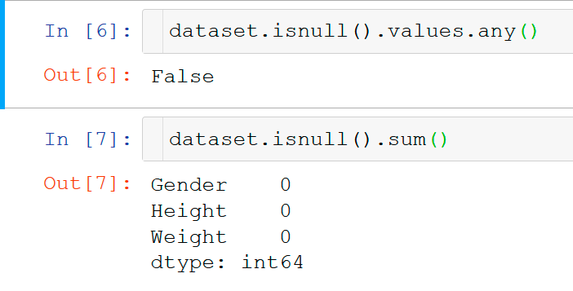
Looking for nulls()
Not Nemo
Run the cells in the notebook
Notes:
Sometimes data sets have NaN ("Not a Number"), or "null“ values.
We need to work with numeric values, so we need to find and correct these.
Generically, this is referred to as "Missing Data" within Pandas.
Pandas refers to these values as "missing data“
Pandas marks values with NaNs, etc, as "null"
We only need to focus on those values.
The first step is to find out if we have any "missing data" in the data frame
We can use a couple of methods within the data frame object for this
dataset.isnull().values.any()
dataset.isnull().sum()
What do you see in the output from the methods?

Slide 13
Zeros in our Data
“Gorillas in the Mist”
Possibility of zeros (0 or 0.0) in the data (remember numerical precision)
Sometimes the data is real and sometimes it isn’t
Need to find zeros that aren’t “correct”
Then we need to fix them (Pandas can’t do this for you)
How do we “fix” them?
Sometimes people will replace them with the variable mean
This keeps the mean the same but might change other statistics
Just remove the data point?
For that data point, the other variables may contain useful data
Moral – be careful how you “correct” data
Notes:
There is also the possibility of zeros, 0.0, appearing in the data. Sometimes
this data is real and sometimes it is not real. You will have to find 0.0 values
that aren't "correct". If we don't find them and correct them, then it's possible
the statistics of the data set will be skewed.
Finding and correcting values that are zero, when they shouldn't be, is an exercise
that is up to the user since Pandas doesn't know what is supposed to be non-zero.
Moreover, how you correct these "zero" values is up to you. Sometimes people
replace them with the mean of that variable so that the overall mean is not skewed.
But beware, doing this can skew other statistics.
Another option is to just remove the data point that contains the zero values
from the data frame. This seems easy enough but when a data point is removed, the
statistics will change. Moreover, the values for other variables may be
useful.
The moral is - be careful what you do when correct data.

Slide 14
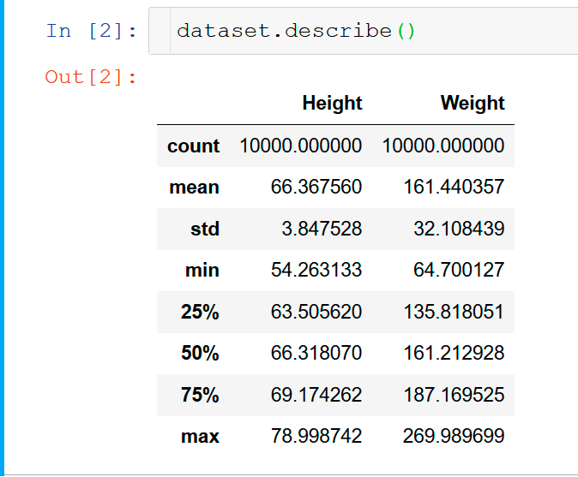
Built-in Statistics
Data Frame has built-in statistics method
Computes:
count (how many rows in each column)
Mean
standard deviation
minimum value
value for 25% percentile
value for 50% percentile
value for 75% percentile
maximum value
Stats for both independent variables for both genders
Run the Cell in the notebook

Slide 15
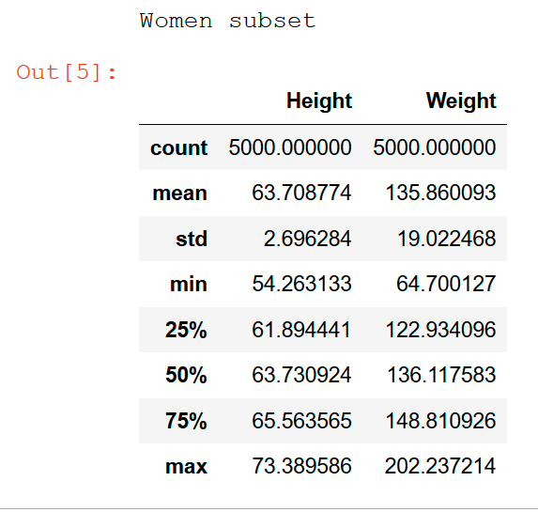
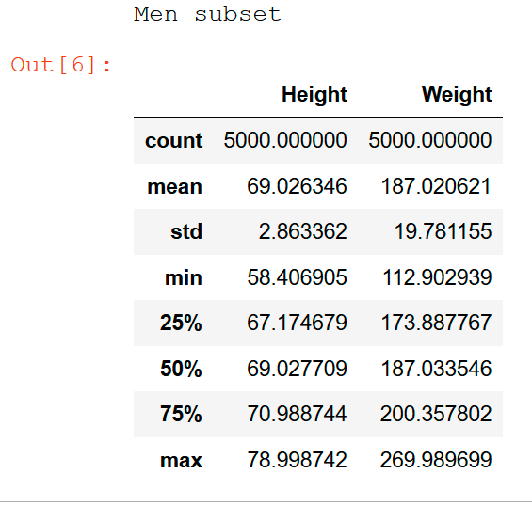
Built-in Statistics for each Gender
Run the cell in the notebook
Notes:
Split the data into the two genders.
Get the statistics on each gender using built-in method

Slide 16
Additional Data Set Statistics
The built-in statistics method, while good, is not very extensive
There are many more statistics that can help describe the data set
median (value in the middle of the data set)
mode (most common values)
Range (max - min)
Variance
Standard Deviation (using mean)
Lots of additional statistics are needed to help complete a data description
Run several cells in notebook

Slide 17
Additional Data Set Statistics
To get “pretty” tables, put statistics into Pandas data frame
Run the notebook cells
Resulting table too large for slides ☺
What stands out in the table?
The mean for the entire dataset is in between that for women and men (as it should be)
The trends for median are the same. Note that median and mean are not the same!
The range for the entire data set is larger than that for women and men. Why?
Much more variance in the entire dataset than each gender. Why?
Standard deviation appears to be a small percent of the mean and median. Perhaps a tighter data set?

Slide 18
Visualization
Numbers are awesome!!
Great way to easily summarize the data set with a few values
Easy comparison to similar data sets
Humans have amazing pattern recognition capabilities
However, we can only visualize so many dimensions at a time
Let’s add to our data set knowledge with visualizations.

Slide 19
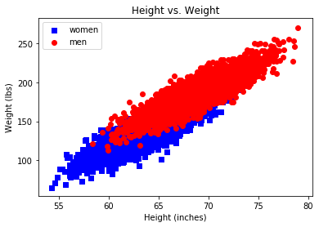
Plot the data
Very simple – plot the data
Whatever that means to you
Watch number of independent variables
I’ve chosen to plot height vs. weight for each gender
Separate scatter plots for women and men
Any observations?
Run the notebook cell
Notes:
1. As you get taller, you get heavier
2. Or, as you get heavier, you need to be taller
3. Some overlap between men and women (60 inches < height < 72 inches) but men are
slightly heavier in this range.
4. No man taller than about 74 inches or shorter than about 58 inches
5. No man heavier than about 262 lbs or lighter than about 115 lbs.
6. No woman taller than about 74 inches or shorter than about 53 inches
7. No woman heaver than about 200 lbs. or lighter than about 65 lbs.
You can visually see the "range" of the data (height and weight) with this kind of plot

Slide 20
Cluster the data
Clustering seeks to collect the data into clusters where the data in each cluster is similar to one another
This can help us discover underlying patterns in the data
This is also fantastic for creating labels!
“Optimal grouping” and where are the groups located? (relative to the variables)
We will be using K-means for clustering
Uses spatial distance to group data points
Goal is to minimize mean distance from centroid of clusters to data points
Iterative process (can fail to find groups)
We need to select value of k before doing analysis (k = number of clusters)
Notes:
Kmeans minimizes distance from centroid to data points for that cluster. Loops over all clusters

Slide 21
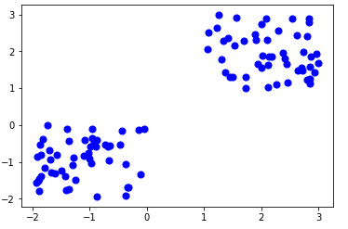
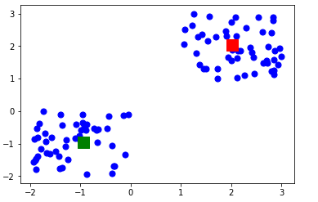
Kmeans Example
Two clusters
(scatter plot)
Two clusters with centroid
(scatter plot)

Slide 22
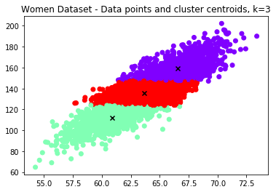
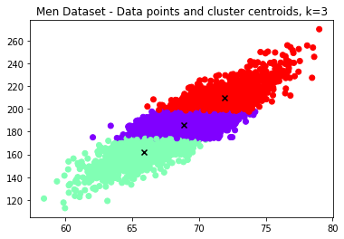
Kmeans for women and men: k = 3
Run the notebook cell
Observations?
Clustering is relatively the same for men and women
So are centroids
The centroids are fairly close to each other
Could this mean that there isn't much data further away from the centroids? Maybe the data is a concentrated near the centroids?
Run the notebook cell
Notes:
Observations:
1. Clustering is relatively the same for men and women (men not shown in slides)
2. So are centroids
3. The centroids are fairly close to each other. Could this mean that
there isn't much data farther away from the centroids? Maybe the data is all
concentrated near the centroids?

Slide 23
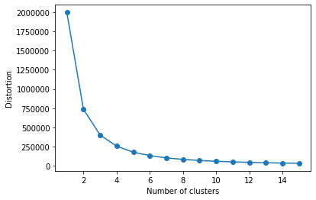
How do you select K?
Use an “elbow” plot
It does data clustering for various values of k and compute distortion
Plot distortion vs. k
Look for lowest distortion
Run the notebook cell
Example used k=1 to k=15
Lowest distortion is for k=15
Is that the best?

Slide 24
First Problem Summary
Pandas is a great tool for data science
Quick data statistics that start to describe or characterize the data set
Panda has quite a few of these method, but sometimes we need to code them ourselves
We may need to “fix” or “clean” our data or understand its faults
Visualization can be a powerful tool, but we’re limited in the number of dimensions.

Slide 25
Second Data set

Slide 26
Second Data Set
Wine Quality
Very popular data set from UCI:
Data set collection curated by University of California, Irvine
Wine quality data set
Only using red wines (I don’t like white wines)
Portuguese "Vinho Verde" wines reviewed by experts
Wine quality is given rating from 1 to 10 (dependent variable)
11 independent variables – chemical analysis of wines
We will do a deeper analysis than the last data set
https://archive.ics.uci.edu/ml/datasets/Wine+Quality

Slide 27
Load needed libraries and read data
For now, just use Pandas and NumPy
Data is stored in a subdirectory named “wine_set”
Better name than the last one
Data is read into a “data frame”
Name “dataset” for this case
Included two plotting tools
Matplotlib
Seaborn
Run the notebook cells
import numpy as np
import pandas as pd
from time import time
import matplotlib.pyplot as plt
import seaborn as sns
%matplotlib inline
wine_set = pd.read_csv("data/winequality-red.csv", sep=';')
Notes:
Read the csv data set into a data frame named “wine_set”
Matplotlib is the swiss army knife of plotting tools in Python
Seaborn is an awesome plotting tool for data science and statistics
We’ll ne using it a lot ☺

Slide 28
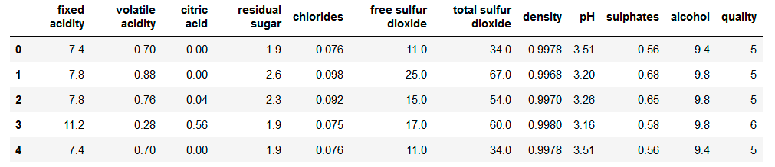
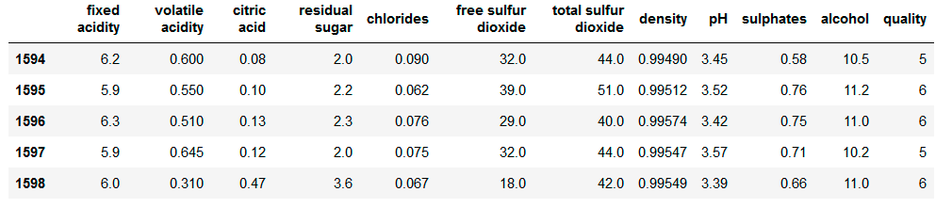
Head and Tail of data frame
Run the cell in the notebook
Notes:
Pay attention to column names (independent variable names)
Start to get a “feel” for typical values for variables.
Examples:
Fixed acidity is below 10
Volatile acidity is below 1
Residual sugar is below 5
Chlorides are below 0.1
Free Sulphur Dioxide is below 50?
Total Sulphur Dioxide is below 100
Density is below 1 (lighter than water?)
pH is below 5? (Remember your chemistry? What is pH of water? - answer=7) This is neutral
Below 7 is acidic
Above 7 is base
Sulphates are below 1
Alcohol is below 20?

Slide 29
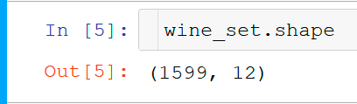
SHAPE of Data
1,599 Data points (rows)
12 columns
11 independent variables
1 dependent variable
12 total
Run the cell in the notebook
Notes:
“shape” is an attribute of the object. There are lots of attributes and methods

Slide 30
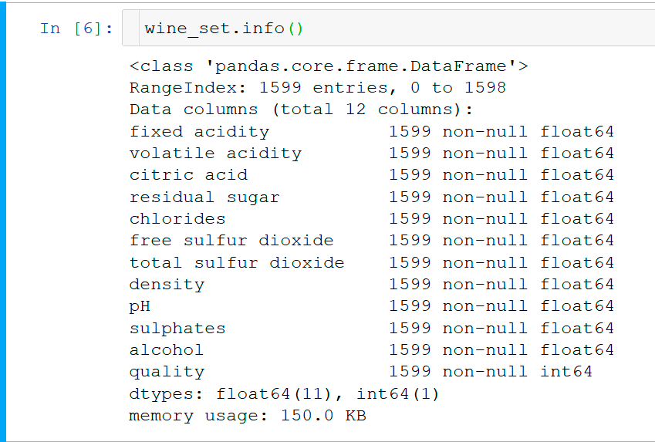
Info() method
Run the cell in the notebook
Notes:
What do you notice?
How much memory is being used for the data frame? (150.0 KB)
Pay close attention to the data types for each variable. Notice that the independent variables are using fp64.
Do these variables need that much precision?
How would you reduce the precision of these variables?
Also notice that the dependent variable, the wine quality, is using int64. The wine quality only ranges from 0 to 10 so isn't int64 a bit of overkill as well?
How can we reduce the precision to int32?
The output refers to "non-null" values. It's possible for the data set to include non-numeric values.
The next section briefly explores that.

Slide 31
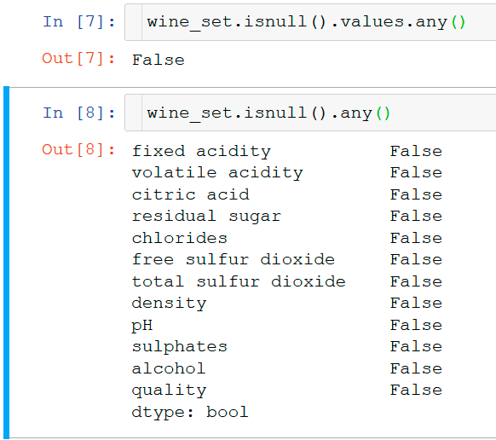
Looking for nulls()
“Looking for nulls in all the wrong places”
Run the cell in the notebook
Notes:
Sometimes data sets have NaN ("Not a Number"), or "null“ values.
We need to work with numeric values, so we need to find and correct these.
Generically, this is referred to as "Missing Data" within Pandas.
Pandas refers to these values as "missing data“
Pandas marks values with NaNs, etc, as "null"
We only need to focus on those values.
The first step is to find out if we have any "missing data" in the data frame
We can use a couple of methods within the data frame object for this
dataset.isnull().values.any()
dataset.isnull().sum()
What do you see in the output from the methods?

Slide 32
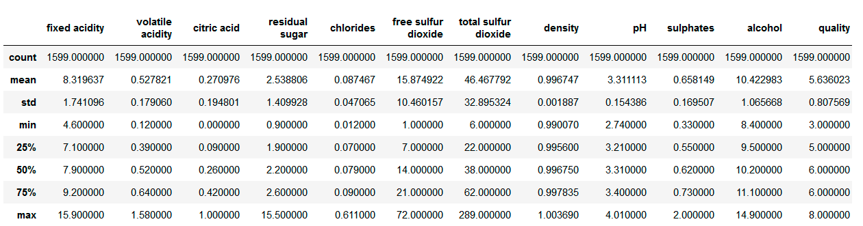
Built-in Statistics
Large Table

Slide 33
Additional Data Set Statistics
To get “pretty” tables, put statistics into Pandas data frame
Resulting table too large for slides
Things you might look for include:
What variables have a large range relative to the mean or median? (small?)
What variables have a large variance relative to the mean or median? (small?)
What variables have a large standard deviation relative to the mean or median? (small?)
What variables have a large or small 25% percentile relative to the minimum?
What variables have a large or small 75% percentile relative to the maximum
Do your answers to these questions involve the same variable?

Slide 34
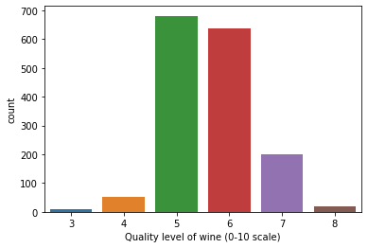
Plot the wine quality (dependent variable)
Just plot the wine quality
Count of each quality
Run the cell in the notebook
Independent of variables
Observations?
Notes:
3 is lowest in data set
8 is largest in data set
Quality of 5 and 6 are largest count (by far)
3 , 4, and 8 have very few values
7 doesn’t have a large number of values relative to 5 and 6.

Slide 35
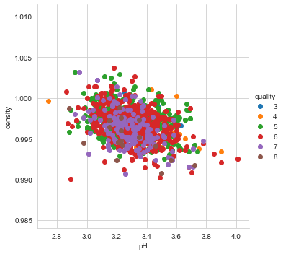
Scatter Plot of Wine quality
Dependent vs. Independent
Seaborn has a nice routine for creating scatter plots as a function of two variables where the dependent variable is color coded
This works well for integer dependent variables like wine quality
Since there are 11 independent variables, you have to pick two
Run the notebook cell
Example is pH and density
What do you observe?
Notes:
You could make a 3D chart if you want so you can address 3 independent variables.
What are the “good” plots?
Try using density, alcohol, or chlorides as one of the independent variables.
Look at density (vs. sulphates, chlorides,
alcohol vs. sulphates
chlorides vs. pH

Slide 36
PAIRplots
A "pair plot" allows us to see both the distribution of single variables and relationships between two variables
The result is a matrix of scatter plots as every independent variable is plotted against all others
These are the x and y axis
The dependent variable, wine quality, is included as in the previous plot (different wine qualities have different colors
Result is 121 plots (11 x 11)
Can take a while to complete
Very difficult to put on a single slide, but let’s try

Slide 37
PAIRPLOTS
Off-diagonal plots are scatter plots of color-coded wine quality
Each variable is plotted against each variable in turn
On diagonal plots are histograms plotted using Seaborn
The Kernel Density Estimation (KDE) are plotted versus the independent variable
KDE is very similar to a histogram
For KDE, the wine qualities are plotted individually with color
“Matrix” of plots is symmetric about the diagonal
You can plot the lower off-diagonal if you like
Notes:
Histograms are bars. KDE is the curved lines

Slide 38
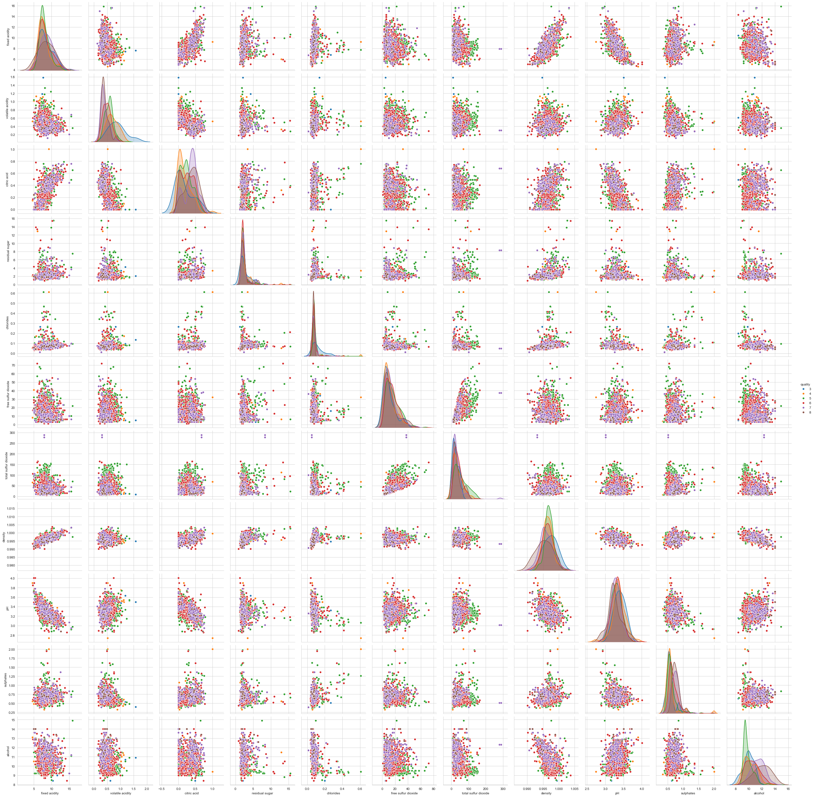
Notes:
For example, is there a particular relationship between two variables? Is the relationship linear?
Is the plot positive? (increase in one variables increases the value of another)
Is the plot negative? (increase on one variable decreases the value of another)
Flat? (horizontal or vertical – could indicate that variables don’t relate to each other)
Be sure to note these relationships because you can use them later as you dive deeper into
the data set.
Note: The upper and lower parts of the plot are the same. To make things easier to
read, you can plot only the lower part of matrix. You use the option, corner=True in the function call.
You can also plot a subset of the independent variables by listing the variables
in a list.For example:
vars = ['fixed acidity', 'pH', 'alcohol']
As a reminder, the independent variables are,
'fixed acidity', 'volatile acidity', 'citric acid',
'residual sugar', 'chlorides', 'free sulfur dioxide',
'total sulfur dioxide', 'density', 'pH', 'sulphates',
'alcohol'
Be sure to look at the diagonal for this case. There is some significant information
from these plots. Be sure to write them down or note them somewhere (noting them in
this notebook is a good place to keep them).

Slide 39
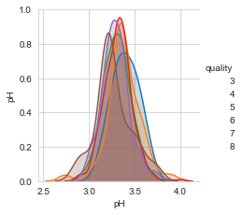
Deeper examination of pairplots
Diagonal Plots
What if you want to do a more in-depth investigation on the specific pair plots?
Reproduce diagonal and off-diagonal plots
Try diagonal first
Independent variable is pH
KDE plot, one curve for each wine quality (dependent variable)
Run the notebook cell
For some unknown reason, the colors don’t show up in legend keys
Still uses the pairplot() method
Observations?
Notes:
Most pH values are centered around a pH of 3.2-3.3.
Without colors in the legend it’s difficult to determine the impact of the wine quality on the pH
-----------------------------------------------------------------------------------------------------------------
sns.set_style('whitegrid')
g = sns.pairplot(wine_set, hue='quality', vars=['pH'], height=3)
#plt.show()
#g = sns.PairGrid(iris, hue='species', size=2)
def f(x, **kwargs):
kwargs.pop("color")
col = next(plt.gca()._get_lines.prop_cycler)['color']
sns.kdeplot(x, color=col, **kwargs)
g.map_diag(f)
g.map_offdiag(plt.scatter)
g.add_legend()
plt.show()

Slide 40
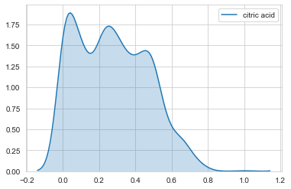
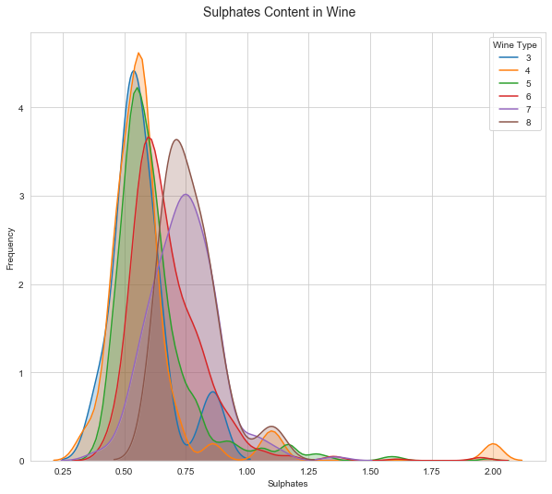
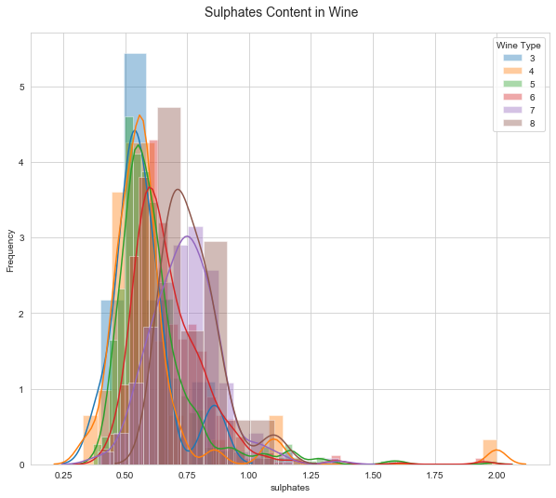
Deeper examination of pairplots
Diagonal Plots – other options
Notes:
Other plotting options that don’t use pairplot()

Slide 41
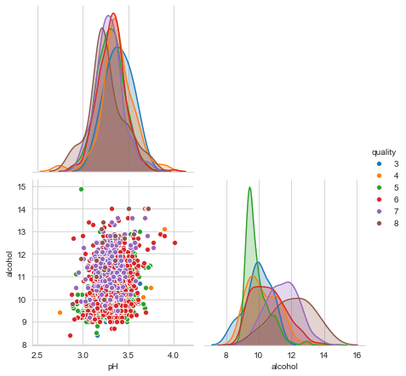
Deeper examination of pairplots
Off-Diagonal
Off-diagonal plots are a little bit more difficult to reproduce using the pairplot() method
You will always get 3 plots
The scatter plot + 2 diagonal plots
It is possible to reproduce the off-diagonal plots using a scatter plot method
Example uses pH and alcohol
Run the cell in the notebook
Next slide is an expanded view of the plot on the right

Slide 43
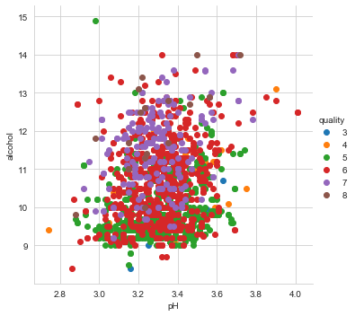
Deeper examination of pairplots
Off-Diagonal Plots – other option
Notes:
Other plotting option that don’t use pairplot()

Slide 44
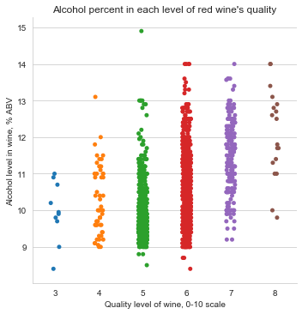
FACTORplots
Factorplots make it easy to separate plots by categorical classes
Great for examining how a variable varies with the dependent variable
Example: How does the alcohol content vary with wine quality?
Great way to visualize “range”
Run the cell in the notebook
What do you notice?
Notes:
What do you notice?
In general, as the alcohol content goes up, the wine quality goes up
Fairly good spread of alcohol content for each wine quality
5 and 6 have a fair amount of data with approximately the same alcohol content
They may have some outliers too ☺
Data seems to be spare for wine qualities of 3 and 8 (maybe 4 as well).

Slide 45
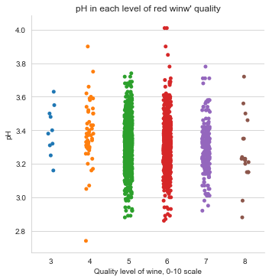
FACTORplots
pH
Notes:
What do you notice?
Not many data points for 3 and 8 (noticed that in last plot)
Somewhat tightly grouped for 5 and 6
6 has some outliers (didn’t show up in last plot)
4 has some outliers at the low end (maybe)
Wines are acidic ☺

Slide 46
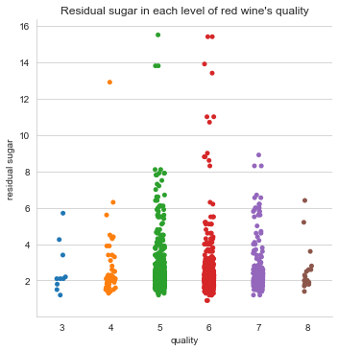
FACTORplots
Residual Sugar
Notes:
What do you notice?
Again, 3 and 8 don’t have too many values
Seems like a wide spread of data
5 and 6 seem to have lots of outliers (didn’t that many with other variables)

Slide 47
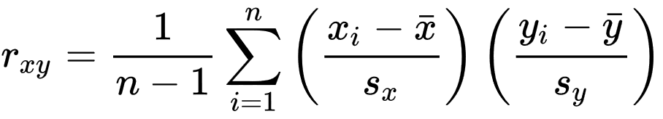
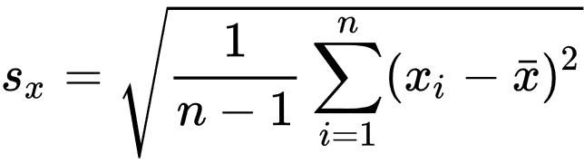
Correlation
Correlation is any statistical relationship between two variables (it can be causal or not)
Most commonly, it refers to the degree to which a pair of variables are linearly related
Correlations can be useful because they can indicate a predictive relationship
Can be used in practice
“correlation doesn’t mean causation”
Pearson Product-Moment Correlation Coefficient (PPMCC)
Standard Scores
Scalar
Standard Deviation

Slide 48
Correlation
Pearson Product-Moment Correlation Coefficient (PPMCC)
Sensitive to linear relationships between two variables
Values from -1 to +1
+1 indicates positive relationship (increase in one variable, increase in second variable)
-1 indicates negative relationship (increase in one variable, decrease in second variable)
Near 0, no relationship
Correlation plots provide a simpler visualization representation of how the variables are related
Easier than scatter plots

Slide 49
Correlation of Features
Heatmap
A great way to look at correlations is to use a heatmap
Create a matrix of variables
Color each cell according to it’s PPMCC value
Dark Red = +1.0
Blue = -1.0
White = 0.0
Coefficients are plotted over all variables for our case)
It’s possible to drop out the dependent variable
Matrix of 144 plots (12x12)
Matrix of plots is symmetric
You can just look at upper or lower diagonal
A great way to understand your data
large positive correlations
large negative correlations
correlations that are close to zero
For large number of variables, a heatmap might be difficult to visualize
May have to search correlation numbers for interesting values

Slide 50
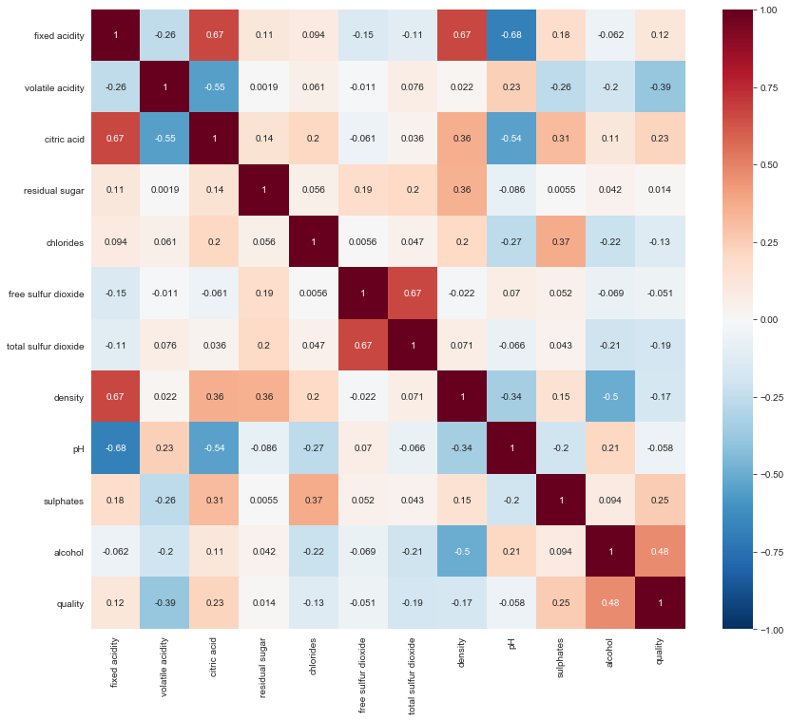

Slide 51
Correlation of Features
Detailed Examination
We can create plots of the data for a pair of variables we identify with the heatmap
Seaborn: regplot()
Creates Scatter Plot
Perform a linear regression using the two variables
Also plots 95% confidence interval
Great way to see relationship of variables
Positive, negative, zero correlations
Scatter
Can look for outliers
We can go one step further
Add Histogram+KDE for each variable
Helps understand data point distribution
Histogram+KDE
Top of plot is for x-axis
Right hand side for y-axis

Slide 52
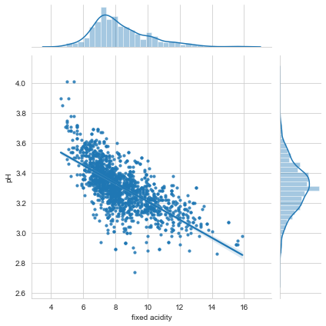
Correlation of Features
Detailed Examination: pH and Fixed Acidity
Notes:
Observations:
Regression is negative correlation (variable increase leads to second variable decrease)
Seems like a fair amount of scatter in the data
Some points seem pretty far from the regression line?
As you can see in the plot, as fixed acidity levels increase, the pH levels drop. Makes
sense doesn't it? A lower pH level is, after all, an indicator of high acidity.

Slide 53
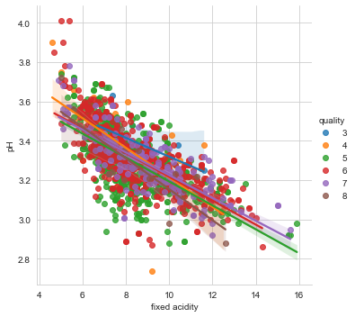
Correlation of Features
Detailed Examination: pH and Fixed Acidity
Notes:
Observations:
Regression is negative correlation (variable increase leads to second variable decrease)
Seems like a fair amount of scatter in the data
Some points seem pretty far from the regression line?
As you can see in the plot, as fixed acidity levels increase, the pH levels drop. Makes
sense doesn't it? A lower pH level is, after all, an indicator of high acidity.
Can use lmplot() to get linear regressions for each wine quality. Right-hand side plot.
It appears that a wine qualities of 5 and 6 are pretty similiar and seem to be close to the overall regression.
As a note, it may be difficult to see, but the 95% confidence interval for a wine quality of 3 is fairly large indicating a fairly large spread of the data (we're seen this previously). I also think the confidence interval for a wine quality of 8 is fairly large as well.

Slide 54
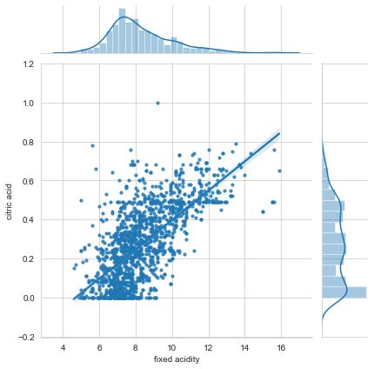
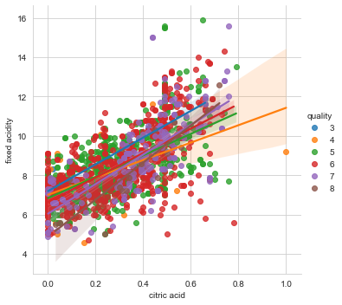
Correlation of Features
Detailed Examination: Fixed Acidity and Citric Acid
Notes:
Observations:
As the amount of citric acids increase, so do the fixed acidity levels. The relationship is somewhat linear although there is a fair amount of dispersion in the data.
The histogram for "citric acid" is interesting. There is a plateau in the data set where the number of data points doesn't vary with the "citric acid" level.
Regression is positive correlation (variable increase leads to second variable increase)
Seems like a fair amount of scatter in the data
Some points seem pretty far from the regression line?
There is a wide range of "fixed acidity" values for a fixed value of "citric acid". Why?
The confidence interval for a wine quality of 4 is very large with respect to these two variables. However, the other wine qualities have a much smaller confidence interval.

Slide 55
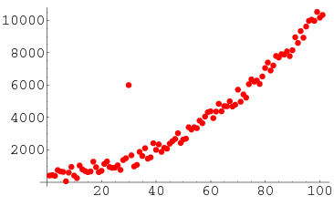
Outlier Detection
Anomaly detection, also called outlier detection, is the identification of rare items, events or observations which raise suspicions by significantly differing from the majority of the data
Outliers can impact statistics and any models that you create
How do you detect them?
Are they outliers for all variables?
Maybe a subset of variables
Are they really outliers?
Do you want to remove them?

Slide 56
OuTlier Detection
Approaches
For this workshop, two approaches will be used:
Visualization Methods
Statistics Methods
Visualization Methods:
Scatter Plots
Box plots
Histograms
Statistical Methods:
Z-score
IQR

Slide 57
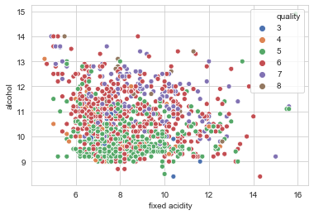
Outlier Detection: Visualization Methods
Scatter Plots
Create scatter plot
Have to select two variables for plot
Will have to create a number of scatter plots to gather all possible outliers
Each wine quality has it’s own color
Scan image to look for possible outliers
Make a list of them for re-examination and possible removal
Sample:
Fixed acidity and alcohol

Slide 58
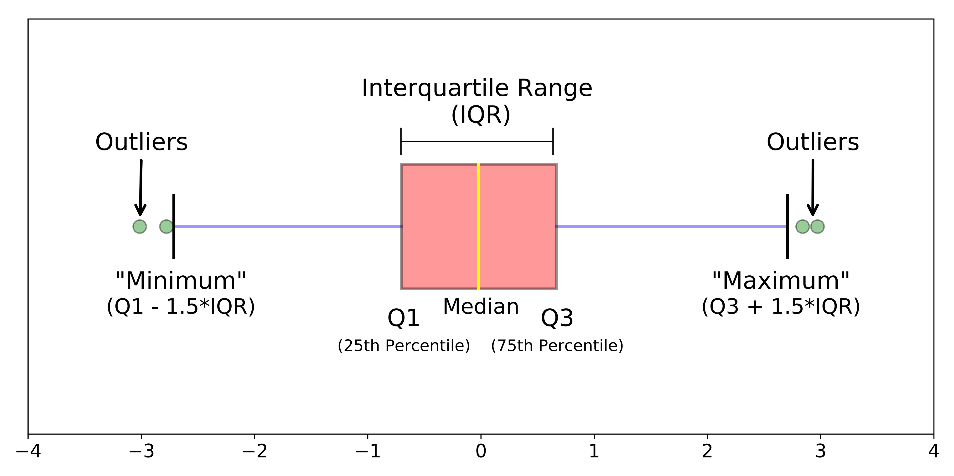
Outlier Detection – BOX PLOT
Start by using Quartile Measures, Q, for each variable
Q1 – 25%
Q2 – 50%
Q3 – 75%
Define “boundaries” or “fences” for variable
Max: Q3 + 1.5*IQR
Min: Q1 - 1.5*IQR
IQR = Q3-Q1
Anything outside of Min/Max is an outlier

Slide 59
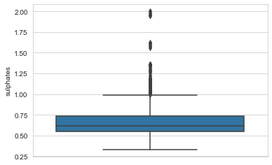
Outlier Detection – BOX PLOT
Sulphates Example – All Wine Qualities
Notes:
All wine qualities are included
Observations:
Looks like there are a number of points that are outliers (greater than upper fence)

Slide 60
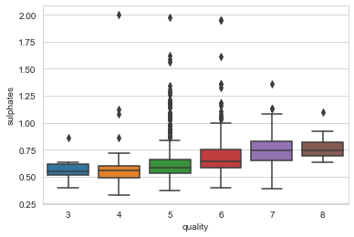
Outlier Detection – BOX PLOT
Sulphates Example – Individual Wine Qualities
Notes:
Observations:
Every wine quality has outliers (greater than the max)
Wine Quality 4 has some outliers that are pretty far out
Quality 5 seems to have a fair number

Slide 61
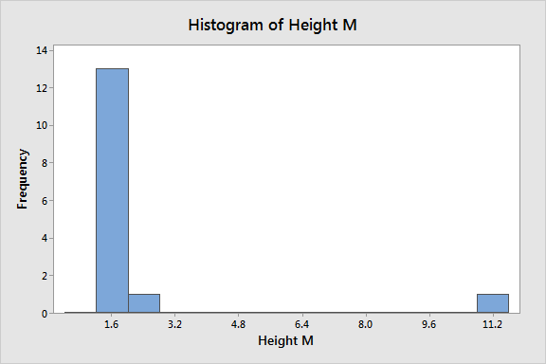
Outlier Detection – Histogram
Create histogram of variable (all wine qualities usually works best)
You can adjust the number of bins
Create histogram
Look for bins that are isolated
These could be outliers

Slide 62
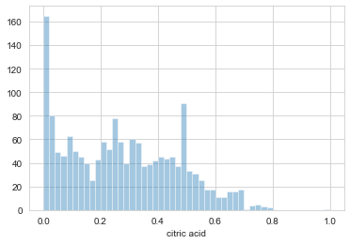
Outlier Detection – Histogram
Citric Acid Example – 50 bins
Notes:
Could be some outliers at the upper end, near 0.7-0.8 value of citric acid
Need to look at all variables – use a loop to create the plots (see notebook)
Looks like outliers at upper end and lower end for some variables
1. 'fixed acidity' (top end)
2. 'vilatile acidity' (top end)
3. Maybe 'chlorides' (top end but very small number of values)
4. 'free sulphur dioxide' (top end)
5. 'total sulphur dioxide' (top end)
6. ' density' (bottom end and top end)
7. 'pH' (bottom end and top end)
8. 'sulphates' (top end)
9. 'alcohol' (bottom end and top end)
You can also look at the lower/upper range of the plots to see if there might be outliers
So far, we’ve been looking for outliers one variable at a time. Are the outliers for one variable, outliers for another?

Slide 63
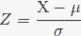
Outlier Detection: Statistical Methods
Z-score
Z-score is a signed, dimensionless fractional number of standard deviations that a point is away from the mean value for each data point
Measure of how many “standard deviations” the data set is away from the mean
"X" is the data point, "mu" is the mean, and "sigma" is the standard deviation
Z > 0 the data point is above the mean
Z < 0 the data point is below the mean
Not a graphical method
Brute force searching through data set
Define an outlier distance or bound
E.g. bound = 3*sigma
Loop over all data points in data set
Compute Z-score for each point
If abs(Z-score) > bound then it’s a possible outlier

Slide 64
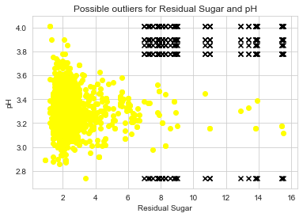
Outliers using Z-score
Two variable example
Notebook has an example for pH
Bounds = 3*sigma
Found 8 possible outliers
In the example, the data point information was not stored
Only the Z-score are printed
The next cell computes the z-score for two variables
If abs(Z-score) > bounds for both variables, then it’s an outlier candidate
Store variable values of candidate outliers
Create a scatter plot (yellow) of two variables
Add plot of candidate outlier points (black)

Slide 65
Outlier Detection: Statistical Methods
IQR
Use IQR measures
Lower and upper bounds are used
Loop over each variable and store data points that fall outside bounds
Min and Max
Tabular data
In the notebook cell, a Pandas table is created for variable and printed
You can take the data for one variable and check it against other variables
Notes:
Observations:
Seems like there are a lot of outliers!

Slide 66
Outlier Summary
Multiply ways to find outliers
Usually done on a per variable basis, but you can search over multiple variables
Questions:
Is the data point truly an outlier?
Is it an outlier for that variable? (it might be useful to keep the data point)
Is it an outlier for other variables?
Do we lose information if we remove the outlier?
When you remove an outlier, re-compute statistics and compare to full data set
Have things changed?
Is that good or bad?

Slide 67
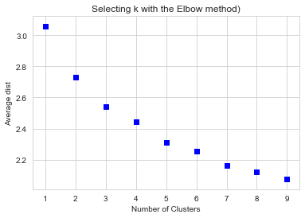
Kmeans Clustering
We’ve already talked about clustering using Kmeans
For out Wine data set, we’re going to split that data set into two groups
Training (used to create the clusters)
Testing (used to test the clusters)
Arbitrarily chose 70% for training (1,119 points), 30% for testing (480 points)
Start clustering with Elbow plot:
Try k=1 to 9 to start
Observations?
Notes:
Minimum is k=9. Is it the “best” number of clusters?

Slide 68
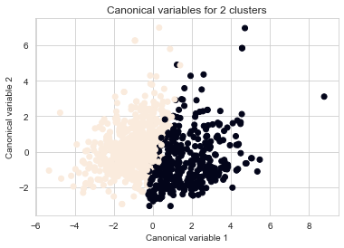


Kmeans Clustering
View of several values of k
k=2 clustering looks simple
k=4 clustering looks more complicated (data seems to overlap)
k=9 Can you make out the various clusters?
What value of k would you chose?
Notes:
K=3 looks pretty good but there are still some overlap
K-2 looks better but still a small amount of overlap
Does overlap mean anything since it’s with respect to PCA variables?

Slide 69
PCA
What happens to our statistical analysis if the data set has a large number of independent variables?
Principal Component Analysis (PCA) allows us to examine the interrelationships among the set of variables
Can identify the underlying structure of those variables
Find the features that don't greatly impact the model, reducing the number of variables. Therefore, we can reduce the time for analysis and model creation.
PCA uses an orthogonal transformation to convert the data into a set of linearly uncorrelated variables called principal components
The transformed variables are sorted so that the first principal component has the largest possible variance and the second principal component has the next largest variance, and so on

Slide 70

PCA - example
PCA is sensitive to relative scaling of the principal variables
Mean is zero. Variance is 1.
Notes:
In the plot on the left, there is lots of variance with respect to both variables
The variables have physical meaning (I hope). Both are needed in data set
In the plot on the right, there is lots of variance wrt PCA1, but not so much PCA2
Results of PCA (basically an eigen analysis)
Possibility of remove PCA2 from the data set (makes data set smaller)
Variables are no longer physically meaningful but can help reduce the number of variables

Slide 71
Reasons for PCA
Do you want to reduce the number of variables, but are not able to identify variables to completely remove from consideration?
PCA helps identify variables with smaller variance
Do you want to ensure your variables are independent of one another?
Easier to understand trends (correlation between variables is reduced)
Are you comfortable making your independent variables less interpretable?
They no longer have physical meaning
If you want to better understand your data
My #1 reason

Slide 72
PCA on Wine Quality
Let’s perform PCA on our data set
SciKit-Learn function allows us to return only a subset of the PCA variables
1 to 11
The first time, let’s see all of the PCA’s
Put the PCA values for all data points into a Pandas data frame
Show Pandas data frame (looks better than an ASCII table)

Slide 73

PCA on Wine Quality

Slide 74

PCA Variances
Notice how the variance ratios decrease
Is this expected?
If you want to reduce the model, you select how many values of PCA you want to keep?
What’s a good cut-off? Why?
Notes:
Yes this is expected – it’s the definition of PCA
Selecting a cut-off is an art, not a science

Slide 75

PCA Variances
Plot
Plotting the variance contributions of each PCA is called a “scree” plot
Where do you draw the line?
Example:
Sum of n=4 variances is 70.81%
Is this good?
Notes:
Which value of n is good? Why?

Slide 76
PCA – Summation table
Create a table of the sum of PCA’s to that number of PCA values
Which value of n (number of components) is good?
Why?
How can you select a number of components less than 11?
Notes:
Which value of n is good? Why?
Doesn’t it depend upon what you want to do with the data set?
May have to use reduced data set to create a “model” to tell what is the best value of n
The only way to select a good number of PCA values, is to create a model and test it (a lot)
Did the reduced models achieve what you wanted?

Slide 77

PCA – SCATTER PLOTS with PCA values
For n=4, we can create scatter plots of the wine quality as a function of the various PCA values
Why do we do this?
What do we expect to learn?
Notes:
What do we expect to learn?
Perhaps if it is possible to reduce the data set or the variables are too tightly coupled

Slide 78



PCA – More SCATTER PLOTS with PCA values

Slide 79
Summary
Data Science is not "push button" where you can create some tables and plots, and call it a day
You need to always need to keep your goals in mind
Data Science is very interactive
Don’t jump directly into modeling a data set
You are likely to end up frustrated and without any real insight
Explore the data set - What is the data set telling you?
Above all:
Practice, practice, practice
Repeat the analysis several times to get a "feel" for the data
Document what you think the data is telling you
Have fun and learn something
Notes:
Jupyter notebooks are very good for data science
Just be careful ☺
Above all:
Practice, practice, practice
Repeat the analysis several times to get a "feel" for the data
Document what you think the data is telling you
Have fun and learn something

Slide 80
Next Steps

Slide 81

Where to go from here?
This workshop is really only the first step in Machine Learning
After understanding your data set (this workshop) you can go on to create models
Predictions or decisions
Example: Linear curve fit of one independent variable (x-axis) and one dependent variable (y-axis)
Supervised, unsupervised, self, active, reinforcement learning, etc.

Slide 82
Algorithms
There is a huge collection of ML algorithms to create models
First – decide what it is you want to accomplish – goal(s)
Then start looking for tools to accomplish your goal(s)
Notes:
Prediction? Classification?

Slide 83
RAPIDS

Slide 84
WHY RAPIDS?
Many (most) of the ML algorithms are single CPU core based
There are some that are multi-core
Data sets are getting larger exponentially
Theoretically, the more data you have, the better the model will be
At some point it takes FOREVER for an algorithm to complete
Plus you may not be able to compute it on your laptop
RAPIDS
Open-source GPU based Machine Learning

Slide 85
RAPIDS — Open GPU Data Science
Software Stack
Data Preparation
Model Training
Visualization
DASK
PYTHON
RAPIDS
DEEP LEARNING
FRAMEWORKS
DASK
PYTHON
DASK
PYTHON
CUDF
CUML
CUGRAPH
CUDNN
CUDA
RAPIDS
DEEP LEARNING
FRAMEWORKS
RAPIDS
DEEP LEARNING
FRAMEWORKS
APACHE ARROW
CUDF
CUML
CUGRAPH
CUDNN
CUDF
CUML
CUGRAPH
CUDNN
CUDA
CUDA
ARROW
ARROW

Slide 86
RAPIDS Components
cuDF (cu “Data Frame”)
Built on top of Apache Arrow
GPU equivalent of Pandas (with some limitations)
cuML (cu “Machine Learing”)
GPU equivalent of scikit-larn with XGBOOST
cuGraph
Graph analytics
RAPIDS does not match every feature – only the ones that make sense for GPUs
Example: cuDF doesn’t do any visualization
Integrates with Dask (distributed computing)

Slide 87
Using RAPIDS
import cudf as pd
import numpy as np
from time import time
import matplotlib.pyplot as plt
import seaborn as sns
%matplotlib inline
wine_set = pd.read_csv("data/winequality-red.csv", sep=';’)
wine_set.head(n=5)
wine_set.tail(n=5)
Only runs on Linux
Available via pip and conda
Use RAPIDS for heavy computational components
Modeling algorithms such as
Then use Pandas for visualization
Can do:
import cudf as pd

Slide 88
Using RAPIDS
Don’t assume that cuDF replaces Pandas for everything
Focus on computationally intense routines with large data sets
Can integrate with Numab and CuPy (see other workshop)

Slide 89
MODIN

Slide 90
MODIN
MODIN is a Pandas replacement that uses multiple cores
Underneath it uses with Dask or Ray
Dask is flexible parallel computing library for analytics (can be run on cluster)
Ray is a framework for building and running distributed applications (can by run on cluster)
Wraps Pandas and deals with data distribution
It covers a fairly large percentage of Pandas functionality, but not all
As of May 2019: ~71%
See Jupyter notebook
Easy to install

Slide 91
MODIN
New data type:
type(df)
modin.pandas.dataframe.DataFrame
This can cause problems with other tools (e.g. Seaborn visualization library)
If function isn’t written in Modin, it will default to Pandas function
Result is returned as modin.pandas.dataframe.DataFrame data type

